Slide 1
Video Based Cricket Shot Classification using modified LRCN Approach
Krithin Ragav, Sriraam C, Lionel Donato

Slide 2
Overview of Presentation
Introduction
Literature Survey
Dataset
Methodology
Architecture
Results
Conclusion

Slide 3
Introduction
Cricket is one of the most popular sports in the world. It ranks as the second most-watched sport globally, behind only football.
There is an increasing demand for advanced technology in cricket, particularly in areas such as gameplay analysis and performance tracking.
Automated cricket commentary systems require enhancements to deliver more accurate and engaging insights.
Existing cricket shot classification methods often depend on manual video analysis, which can be labor-intensive and susceptible to human error.
This project introduces a modified Long-term Recurrent Convolution Network (LRCN) model aimed at automating the classification of cricket shots from video footage, enhancing accuracy and efficiency.

Slide 4
Literature Survey
Experiment | Authors | Methodology | Disadvantages
Cricket Shot Detection from Videos | A. Semwal, D. Mishra, V. Raj, J. Sharma and A. Mittal | DCNN | computationally intensive, data-hungry, difficult to interpret, prone to overfitting and adversarial attacks, resource-heavy for deployment, and may struggle with capturing long-range dependencies.
Cricshotclassify: an approach to classifying batting shots from cricket videos using a convolutional neural network and gated recurrent unit | Sen, Anik, et al | VGG16 + GRU | computationally demanding and memory-intensive due to the deep VGG16 architecture, requires large datasets to avoid overfitting, is challenging to interpret, struggles with processing long sequences as GRUs can lose context over time, and may be slower to train and deploy compared to more streamlined architectures.
Cricket shot classification using motion vector. | Karmaker, D., et al. | 3D MACH | 3D-CNNs (3D MACH) are computationally intensive, require large labeled datasets, are prone to overfitting, struggle with capturing long-term dependencies, are challenging to deploy on low-power devices, and can be sensitive to noise and occlusions in video data.
Deep cnn based data-driven recognition of cricket batting shots | Khan, Muhammad Zeeshan, et al. | 3D CNN | 3D-CNNs (3D MACH) are computationally intensive, require large labeled datasets, are prone to overfitting, struggle with capturing long-term dependencies, are challenging to deploy on low-power devices, and can be sensitive to noise and occlusions in video data.

Slide 5
Dataset
CricShot10 is a video action recognition dataset consisting of 10 cricket batting shots. This dataset was developed using the videos from YouTube. Video samples were collected considering all the three formats of cricket match: Test, ODI, and T20.
Shots(Classes) included: Cover drive, Defense, Flick, Hook, Late Cut, Lofted Shot, Pull, Square cut, Straight drive, Sweep

Slide 6
Methodology
Data preprocessing:
Frame Extraction, Frame Resizing, Normalizing Pixel Values, Feature Extraction, Feature Shuffling
Frame extraction from video:
Frame focus, convert pixel values
Feature extraction from frames
Data shuffling and splitting
Training LRCN model
Model testing and evaluation

Slide 7
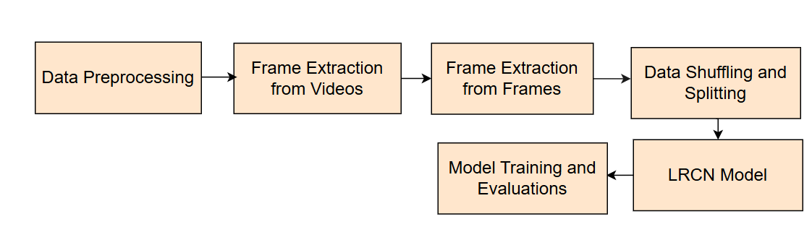

Slide 8
Architecture
1. TimeDistributed Layers
The TimeDistributed layer is used to apply the same operation (such as convolution or dense transformation) to each frame independently in a sequence of frames. It essentially wraps other layers so that they process each frame (or "time step") separately. Used for processing frames in sequence.
2. LSTM Layer (Long Short-Term Memory Layer)
The LSTM layer is a type of recurrent neural network (RNN) layer designed to handle sequential data. It helps the model capture temporal dependencies across frames, which is important for tasks where the order of frames affects the prediction (like actions in videos).

Slide 9
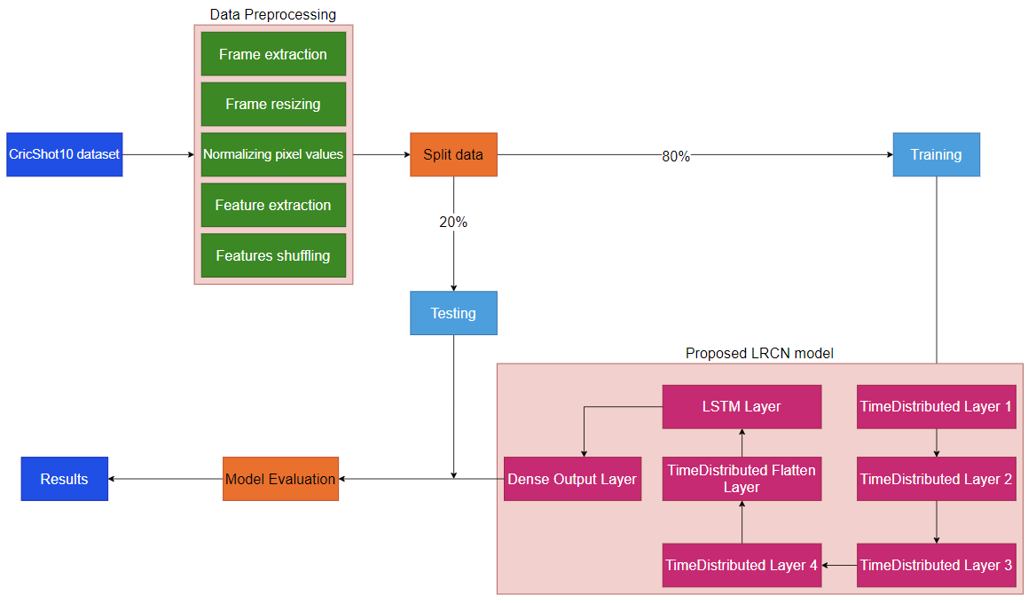

Slide 10
3. TimeDistributed Flatten Layer
The TimeDistributed Flatten layer reshapes the feature maps from each frame into a one-dimensional vector, preparing them for further processing.
4. Dense Output Layer
The Dense (fully connected) layer is responsible for producing the final classification output. It combines the learned features from previous layers to make a decision about the input sequence.

Slide 11
5. Batch Normalization: Stabilizes training by normalizing activations, improving convergence speed.
6. Max Pooling: Reduces spatial dimensions by selecting the maximum value in each region, focusing on key features.
7. Dropout: Regularizes the model by randomly dropping neurons during training, reducing overfitting.
8. Early Stopping: Halts training if validation performance doesn’t improve for 5 epochs, restoring the best model weights to prevent overfitting.

Slide 12
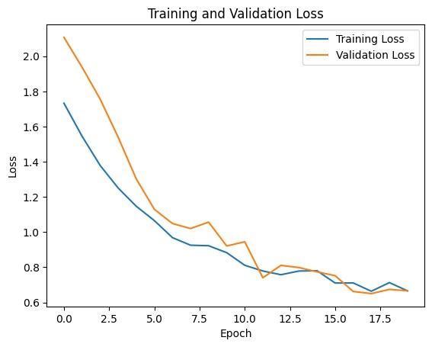
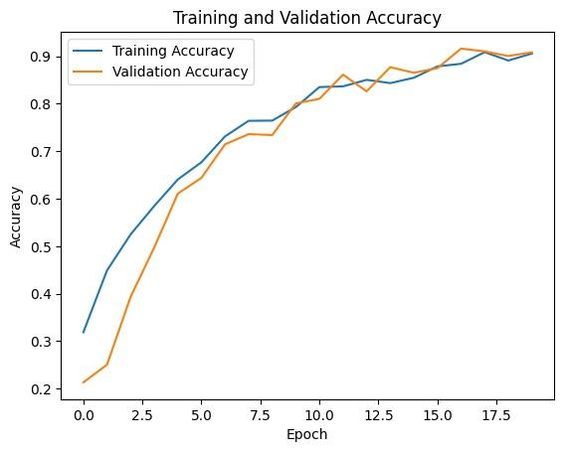
Results
The proposed model achieved a good accuracy score of 96%, surpassing previous models for the purpose of cricket shot detection.
The training and validation loss over epochs, indicating the performance of the proposed model as it learns from data. The trend of both curves decreasing over time suggests that the model is improving its ability to predict outcomes.

Slide 13
Comparison of proposed model’s performance with other methods
Experiment | Methodology | Accuracy
Cricket Shot Detection from Videos [1] | DCNN | 83%
Cricshotclassify [9] | VGG16 + GRU | 93%
Motion Vector [16] | 3D MACH | 60%
Deep CNN [17] | 3D CNN | 90%
Proposed Model | LRCN | 96%

Slide 14
Conclusions
In conclusion, this paper proposes a modified Long-term Recurrent Convolutional Network (LRCN) approach is proposed for video-based cricket shot classification.
The combination of Convolutional Neural Networks (CNNs) and Long Short-Term Memory (LSTM) networks is leveraged to extract both spatial and temporal features from cricket shot videos.
The proposed model is trained and evaluated using the CricShot10 dataset, resulting in high classification accuracy.

